Slide 1
Predict Invoice Payment Status GE Power and Assessment of vender performance, according to the amount due
Business Solution
some confidence Interval (CI) )
Predict invoice status ( on-time payment or delayed) , using classification model(Machine Learning and Regression model
Built a model for point Forecast of delay days count ,for the next couple of months
Assessment of customer performance, according to the amount due remaining with respect to aging days(number of due days count)
Regression Technique helps predicting delay /on-time invoice payment
Using Forecasting model , we can forecast the future delayed days count
Using statistical data analysis , suggestion can be given to GE on number of delayed periods according to vendor , so that GE can plan accordingly.
Use tool stack like Python, R, MS Azure, IBM Watson, AWS etc. to provide similar insight on data & analytics
GE can predict the trust worthiness of the customer and based on their goodwill ,can offer some discounts or penalize bad vendors
GE can concentrate on selected customer who have not paid with highest amount due and with highest number of pending due days
GE can do risk mitigation accordingly in terms of financial loss that may happen considering future projection.
Objective
Methodology
Benefits
About the Data
This is a GE Invoice data where GE has to get money from different Vendors (AIR NEWZEALAND,INTERNATIONAL PAPER, TENNESSEE VALLEY AUTHORITY) which is due , because of various reasons.
Attached Invoice Data

Slide 2
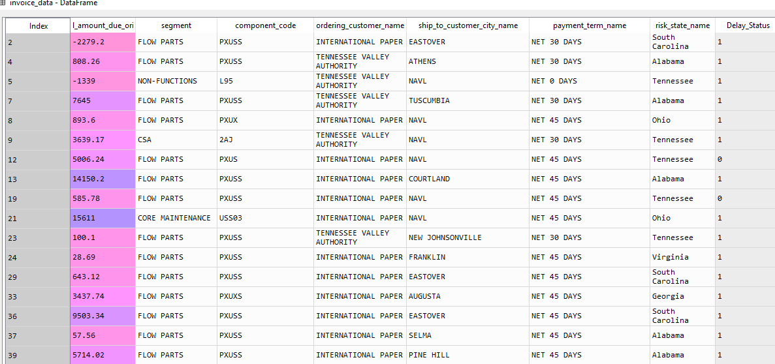
Delay_Status is response variable and rest are predictors Significant Column has been recognized based on filter based statistical test for Categorical variable using Chi-Squire test and Wrapper based (automated method) using ML method Boruta-py method where algorithm automatically ranks the predictors and give back the axact significant input predictors which can be taken for model build

Slide 3
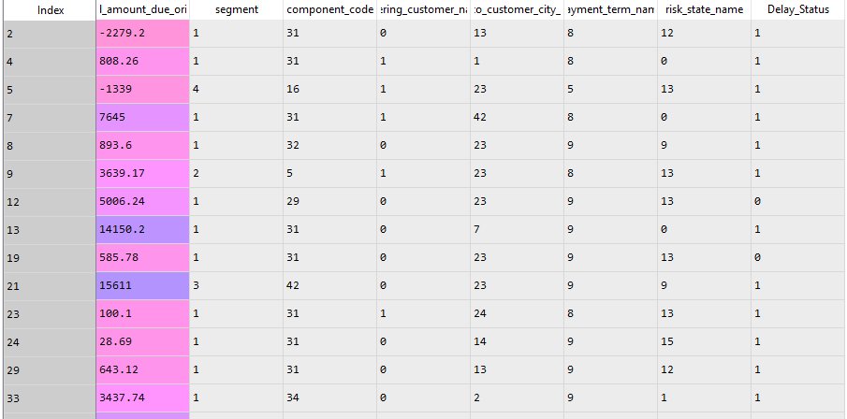
GE Power Invoice Data Analysis
Possible Use Cases:
Predict invoice status ( on-time payment or delayed) , using Machine Learning models
Forecast delay days count ,for the next couple of months
Evaluate number of delay period using statistical analysis
Rank the most valuable Vendor with less due amount
Analyze Vendor behavior with respect to Payment Due
Intuition : Predict whether the invoice payment will be delayed or will be on-time
Approach
From the invoice data, number of delay days has been calculated(Invoice close date – invoice due date)
If delay day count is more than zero , we call it as payment delayed , and if it is 0 or less than zero we classified as on-time payment
Delayed payment =1 , On-time = 0
Categorical variables are encoded and the variable selection has been taken according to wrapper based algorithm.
Amount due original , Payment due reason are the predictors which has been taken into consideration for predicting whether the invoice will be delayed or on-time
Model has been built (Logistic , Random Forest ensemble)

Slide 4
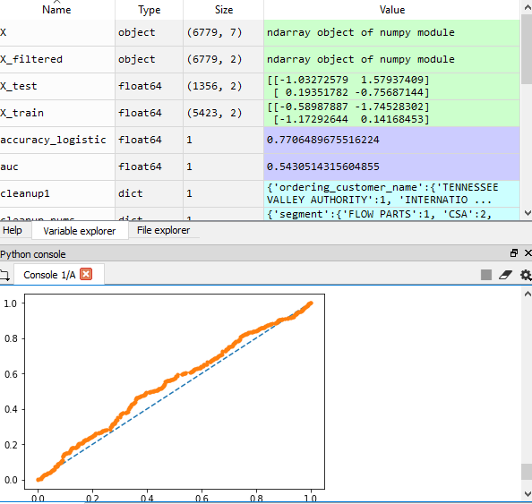
Model Building,Prediction,Model Evaluation
Logistic Regression, Random Forest model has been built t o predict whether invoice payment will be Delayed/on-time.
Model is built in Python
Accuracy of 77% , model can predict whether invoice payment will be delayed or not.
Model seems over fitted which can be overcome by regularisation or sampling method.

Slide 5
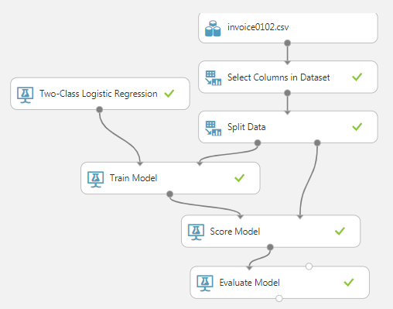
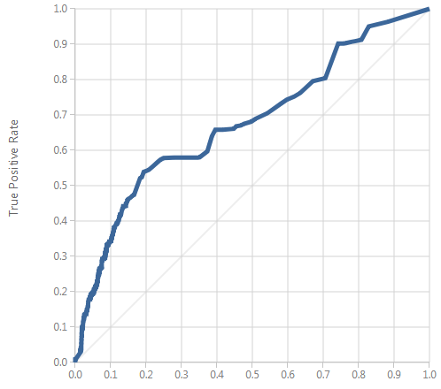
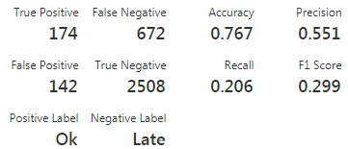
Two-Class Logistic Regression for Delay Prediction

Slide 6

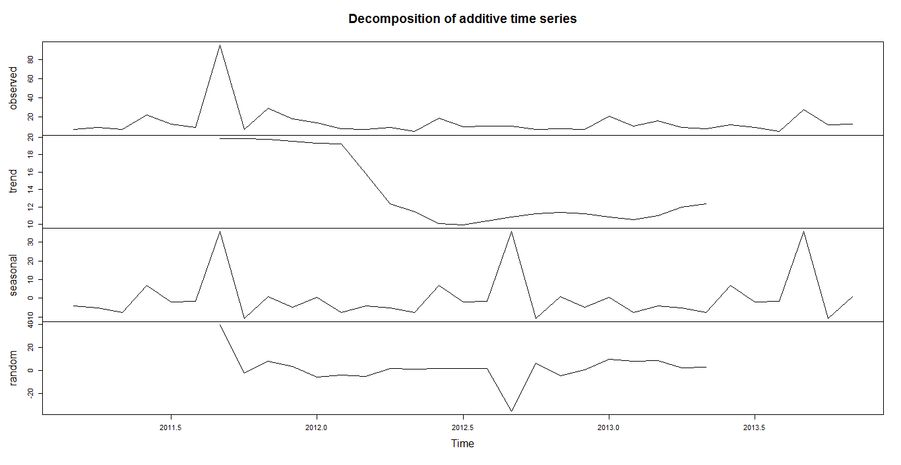
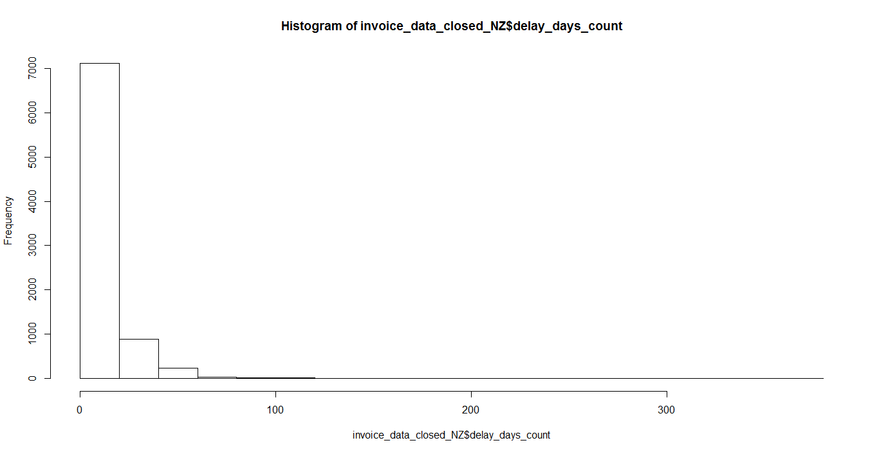
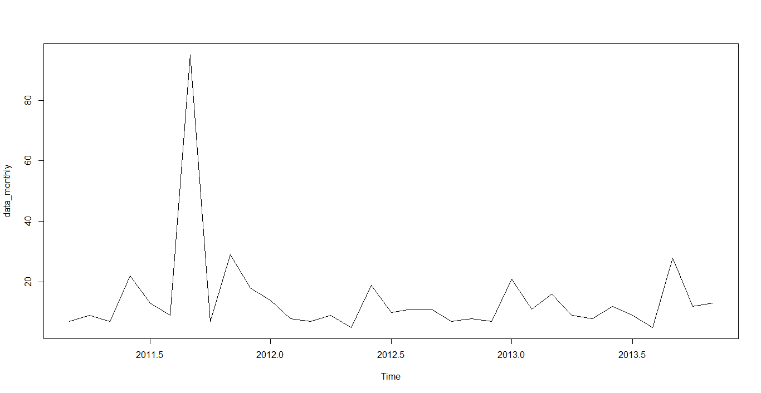
Forecast Number of Delay Day or amount that may happen for up-coming years
Monthly forecasting of (number of payment delay days ) for different Vendors(AIR NEW ZEALAND , INTERNATIONAL PAPER, TENNESSEE VALLEY AUTHORITY)
AIR NEW ZEALAND
Monthly time series data (with respect to number of days due)
We can see some peaks in data in may and June 2011
Distribution of number of due day count (data some what right skewed)
i.e distribution is an asymmetric not normal distribution
Decompose the data to see if there exists some seasonality/trend/randomness exists in the data which should be removed for forecasting. We can see , there exists some seasonality in the data , which we may need to remove to make data stationary for forecasting .

Slide 7
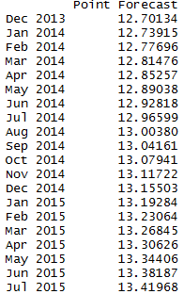
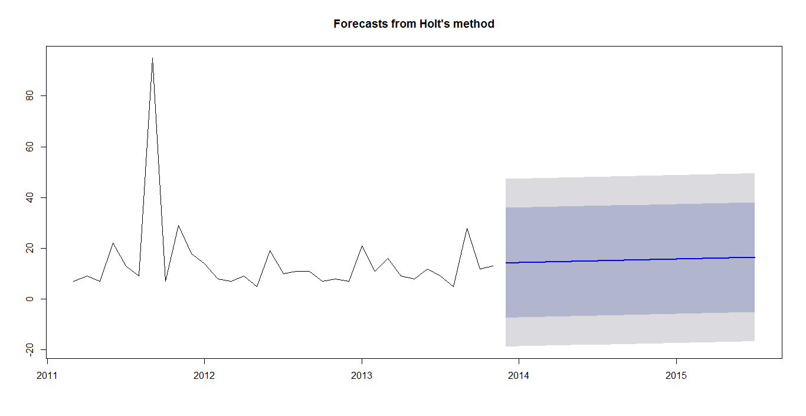
After removing seasonality in the data , forecasting is done , from dec 2013 till jul 2015 we will have 12 to 13 days delay is forecasted . Benefit : This model will forecast the delay period for next couple of years.

Slide 8
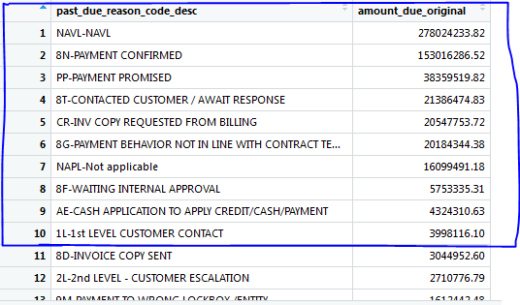
Reasons of delay in invoice payment with amount due($) Top 10 reasons for delay(Highlighted)

Slide 9
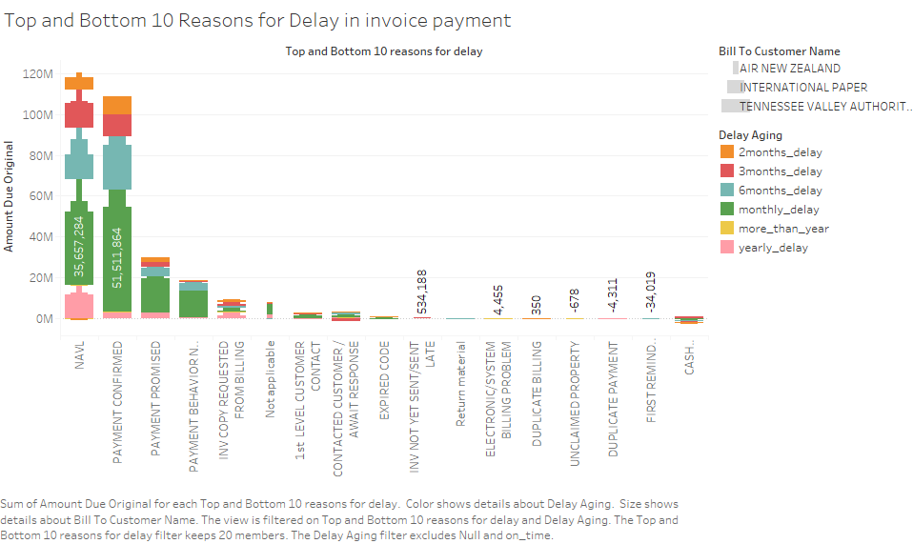
Rank the most valuable Vendor with less due amount

Slide 10
Conclusion:-
GE can take advantage of predictive modelling and forecasting technique ,to know the trust worthiness of the vendor and based on their goodwill of the vendors ,can offer some discounts or penalize bad vendors
GE should pay attention to the vendor specially TENESSE VALEY AUTHORITY, TENNESSE VALEY AUTHORITY MONGOLIA CT PLANT, INTERNATIONAL PAPER COMPANY
Technical Issues can be avoided in billing system from GE side , which saves approximately 10 % of total amount due.

Slide 11


Slide 12
Appendix

Slide 13
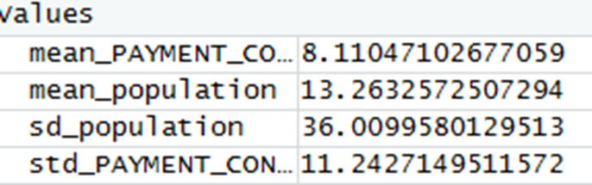

Statistical Analysis : Intuition : To analyse Delay days range per reason
Some Statistical analysis For reason of delay category NAVL , delay range will be 9 to 11 days
Some Statistical analysis For reason of delay category NAVL , delay range will be 9 to 11 days
Lets consider 1st reason for due NAVL( Delay range will be from 9 to 11 days with 95% CI)
One Sample z-test
data: NAVL$delay_days_count
z = -4.2378, n = 10055.00000, Std. Dev. = 36.00000, Std. Dev. of the sample mean =
0.35901, p-value = 0.00002257
alternative hypothesis: true mean is not equal to 12
95 percent confidence interval:
9.774913 11.182223
sample estimates:
mean of NAVL$delay_days_count
10.47857
Lets consider 2nd reason for due reason code/description : ‘PAYMENT CONFIRMED’ ( Delay range will be from 6 to 9 days with 95% CI)
One Sample z-test
data: PAYMENT_CONFIRMED$delay_days_count
z = -5.8692, n = 2951.0000, Std. Dev. = 36.0000, Std. Dev. of the sample mean =
0.6627, p-value = 0.000000004379
alternative hypothesis: true mean is not equal to 12
95 percent confidence interval:
6.811600 9.409342
sample estimates:
mean of PAYMENT_CONFIRMED$delay_days_count
8.110471
Similarly we can calculate for other top reasons with delay date range

Slide 14
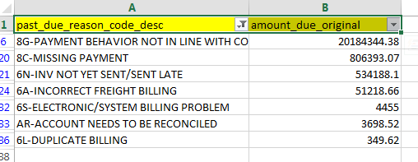
Reason of delay due to technical issue in Billing System
Benefit
GE can avoid the pending due amount happening due to technical issue in billing system.

